Slide 1


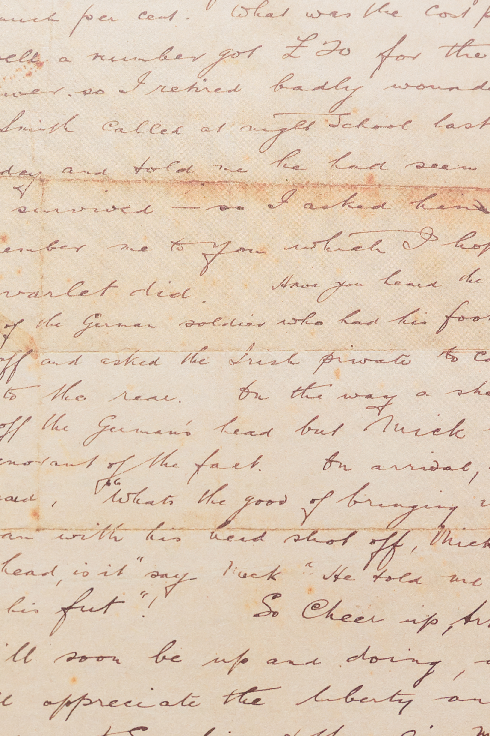
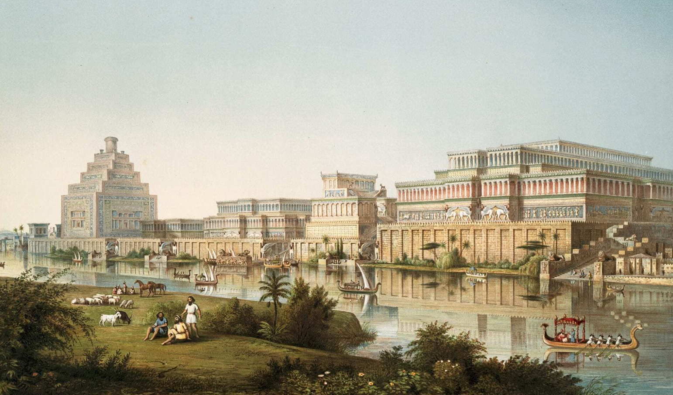
HUM 101
Presenters
Mashroor A Jawad
Ramisa Huda
Umme Abira Azmary
Nahiyan asgar chowdhury
First Empires: Assyrians and Persians

Slide 2


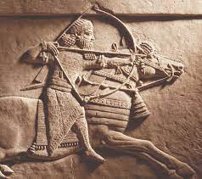
SOCIAL
HIAERCHY

Slide 3
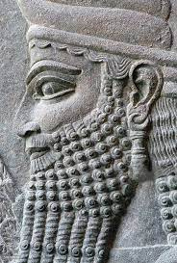
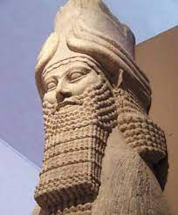
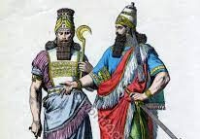
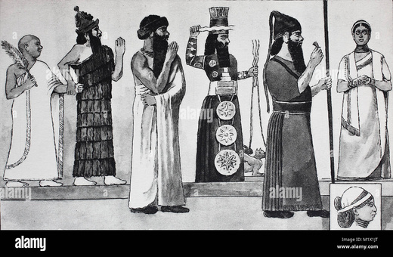
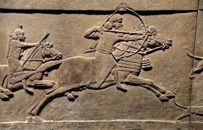
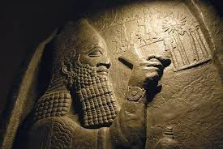
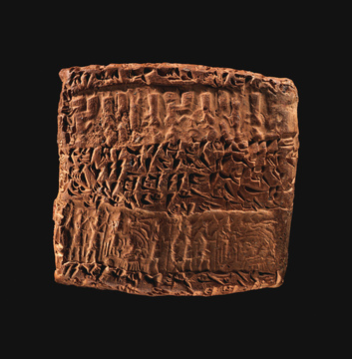
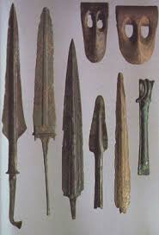
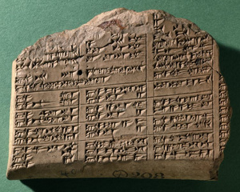
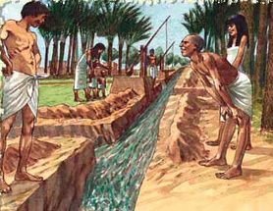
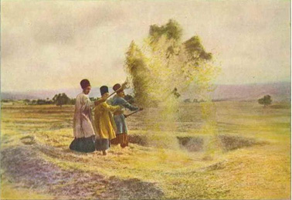
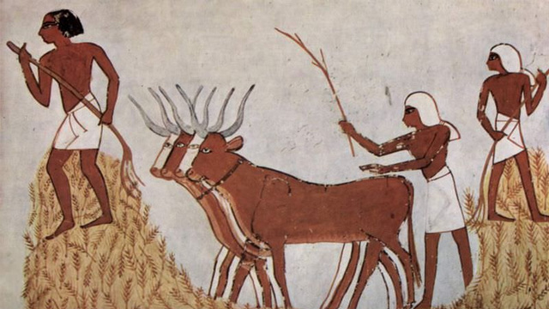
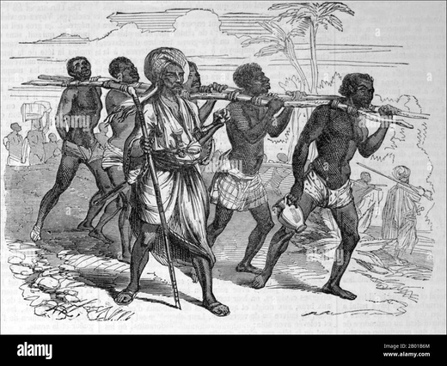
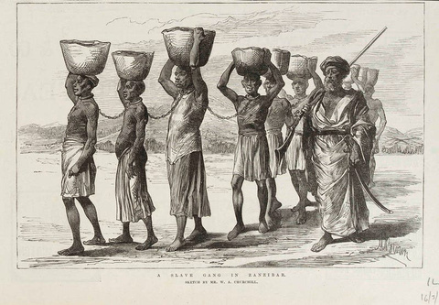
H
I
E
A
R
C
H
Y
ki
KINGS
S O C
I
A L
2. THE ELITES- Nobles, Priests, Provincial Government
3. ARMY
4. ARTISANS
5. FARMER
6. SLAVES

Slide 4
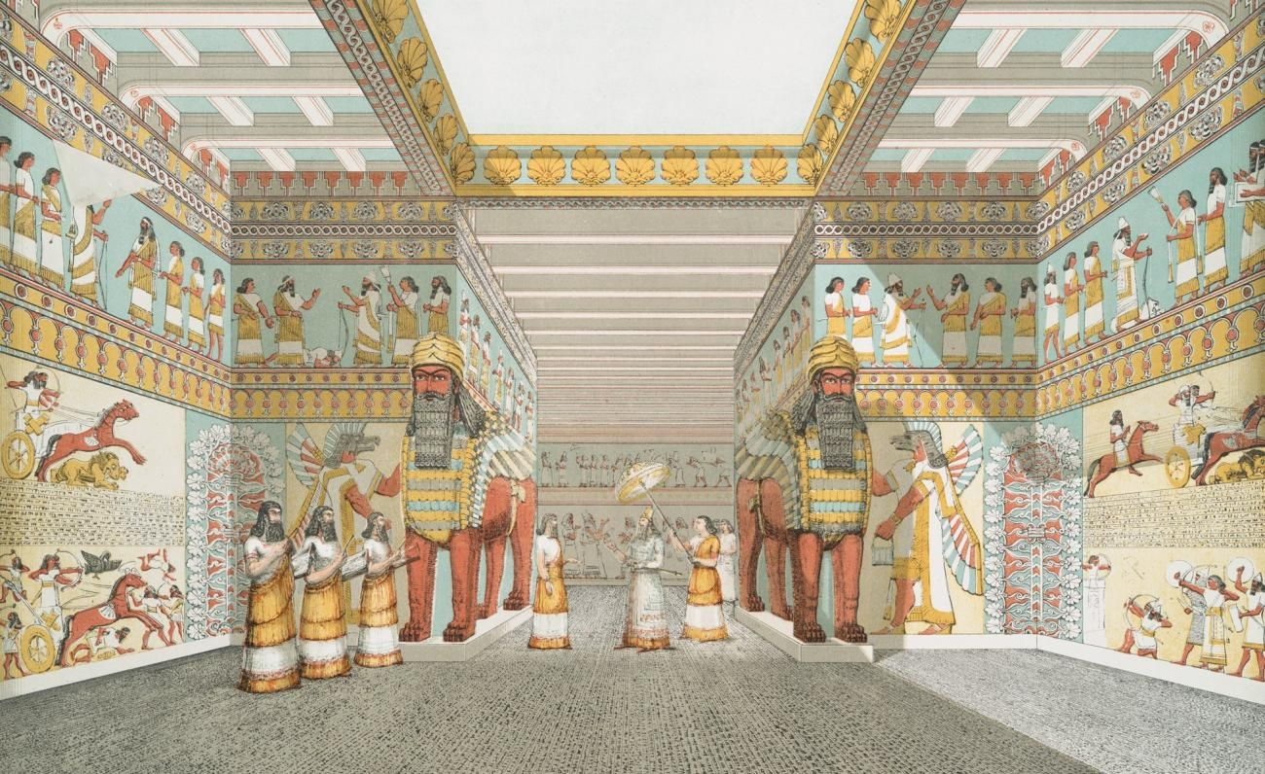
LAW AND GOVERNANCE

Slide 5

ASSYRIAN LAW AND GOVERNANCE
BASED ON ROYAL DECREES ISSUED BY THE KING.
LOCAL TRADITIONS PLAYED A ROLE.
NO SINGLE CODIFIED CODE OF LAWS.
POWERFUL BUREAUCRACY.
SCRIBES, JUDGES, TAX COLLECTORS, AND PROVINCIAL GOVERNORS.
EMPHASIS ON EFFICIENCY AND CENTRALISED CONTROL.
HARSH PUNISHMENTS FOR CRIMES.
PENALTIES VARIED BASED ON SOCIAL STATUS.
LIMITED RIGHTS FOR COMMONERS.

Slide 6
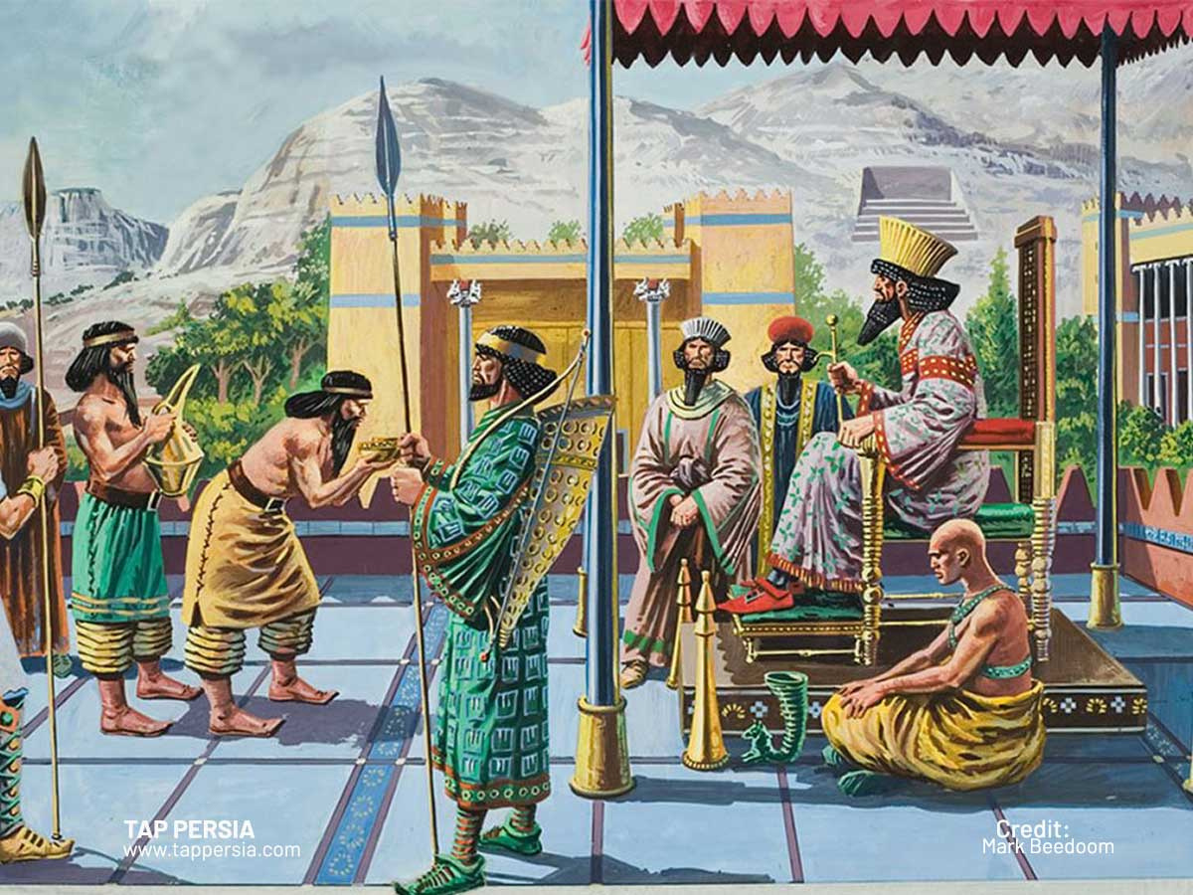
PERSIAN LAW AND GOVERNANCE
DECENTRALIZED SYSTEM WITH SATRAPS GOVERNING PROVINCES.
Royal edicts established basic laws and principles.
Satraps held significant power in their provinces.
ROYAL INSPECTORS ENSURED LOYALTY AND COMPLIANCE.
EMPHASIS ON CULTURAL INTEGRATION AND RELIGIOUS TOLERANCE.
GENERALLY LESS HARSH PUNISHMENTS THAN ASSYRIANS.
EMPHASIS ON RESTORATIVE JUSTICE AND RESOLVING DISPUTES PEACEFULLY.
MORE RIGHTS FOR WOMEN AND MINORITIES COMPARED TO ASSYRIANS.

Slide 7
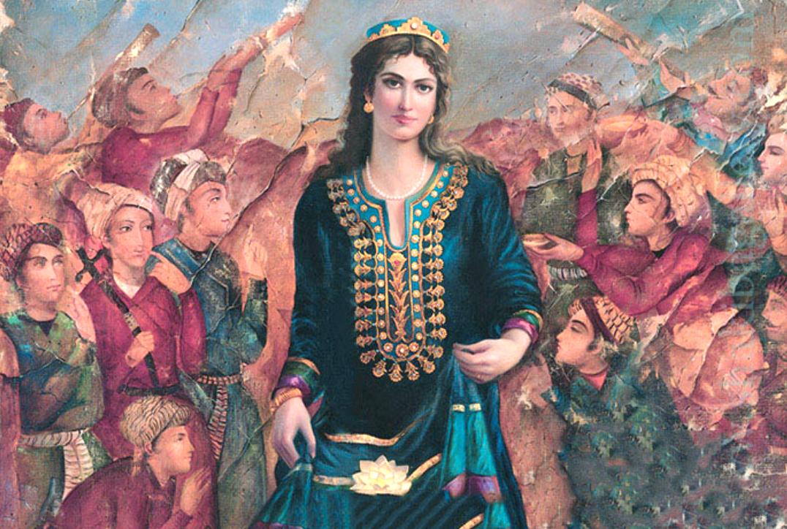
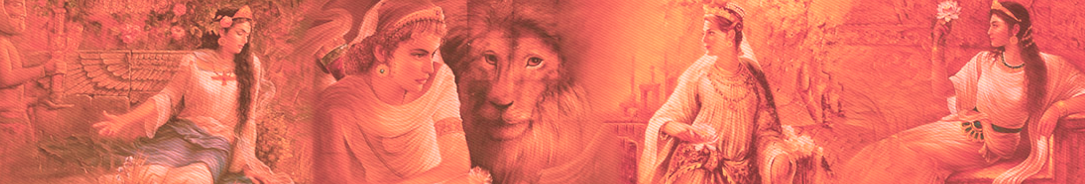
ROLES OF WOMEN

Slide 8
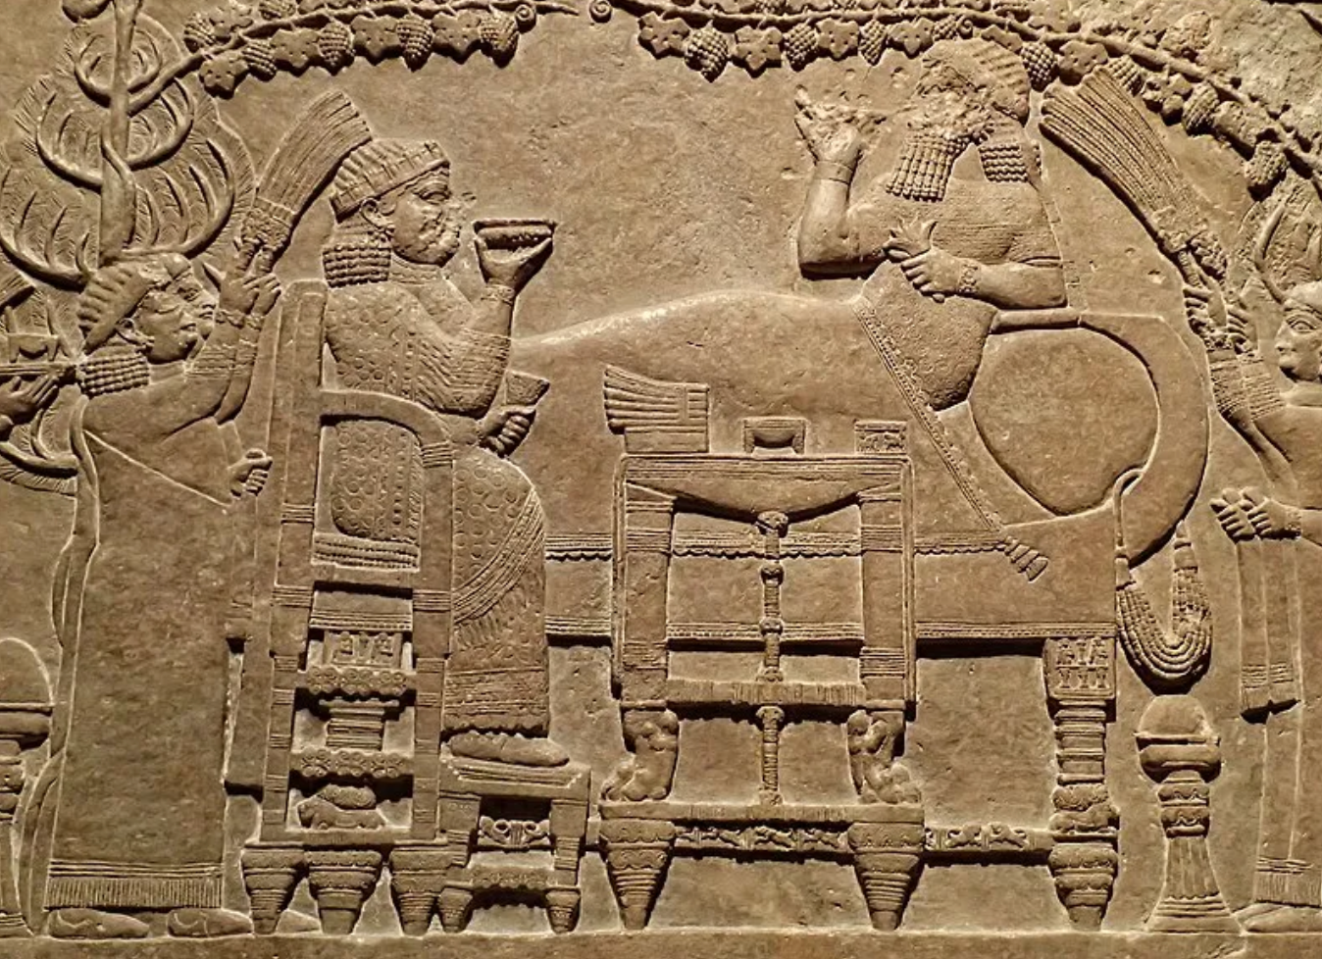
Marriage AnD Motherhood
Daughters, wives, and mothers
Daughters often married young, age gaps between spouses
Infertility led to social challenges
Women could initiate divorce

Slide 9
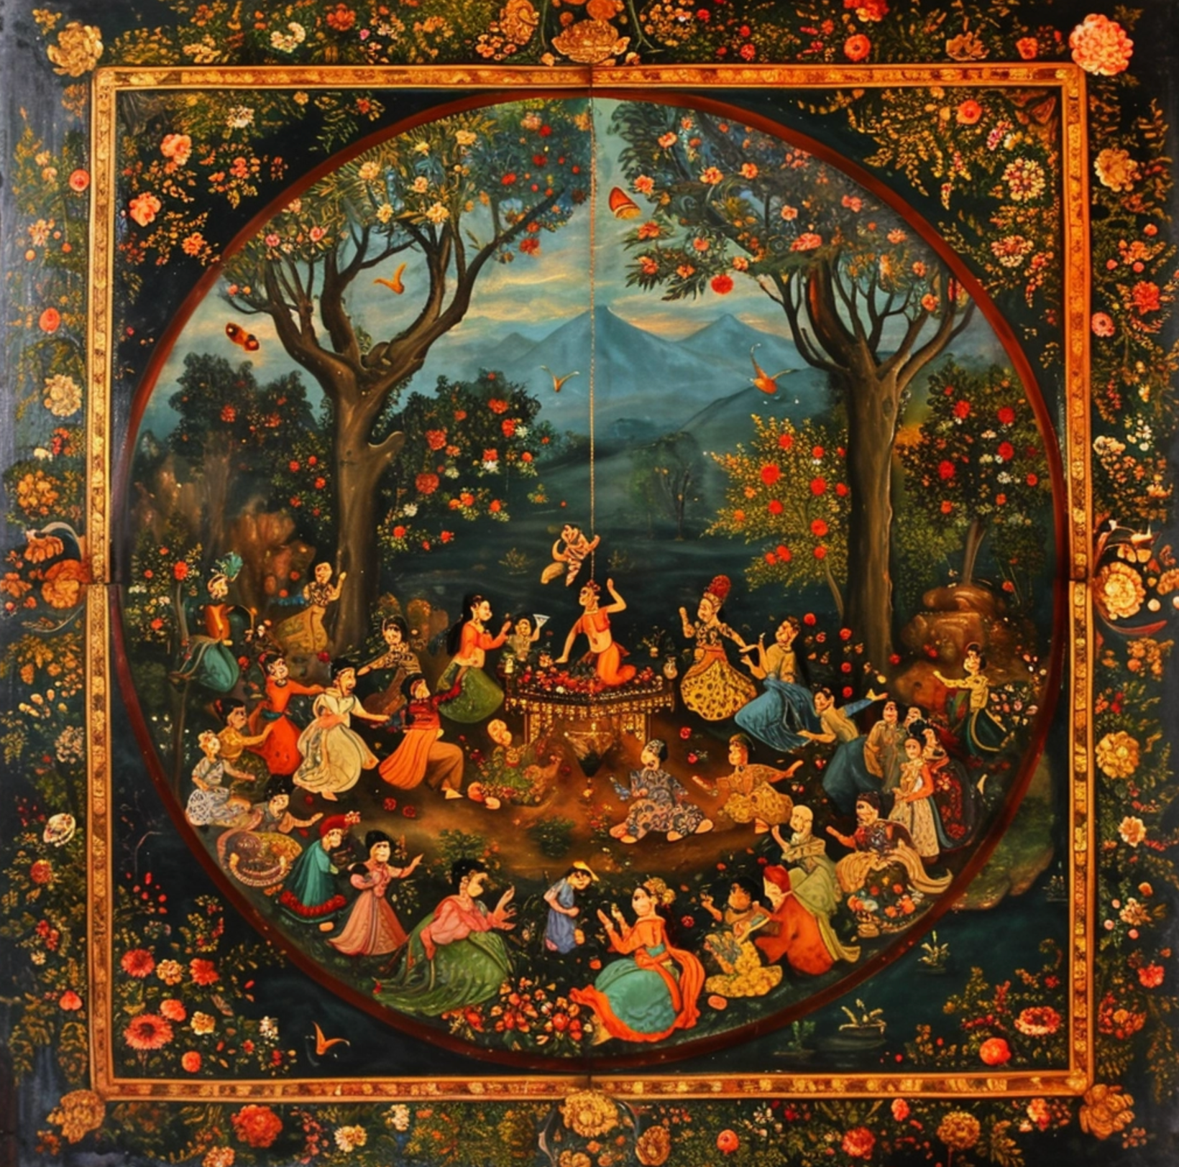
Persian
Own property, participate in economic activities
Participated on politics, played role as General
Zoroastrianism - No slave
Assyrian
No right to participate in any social activities
Worked on palace as dancers or female singers
Polytheistic - Female slaves

Slide 10
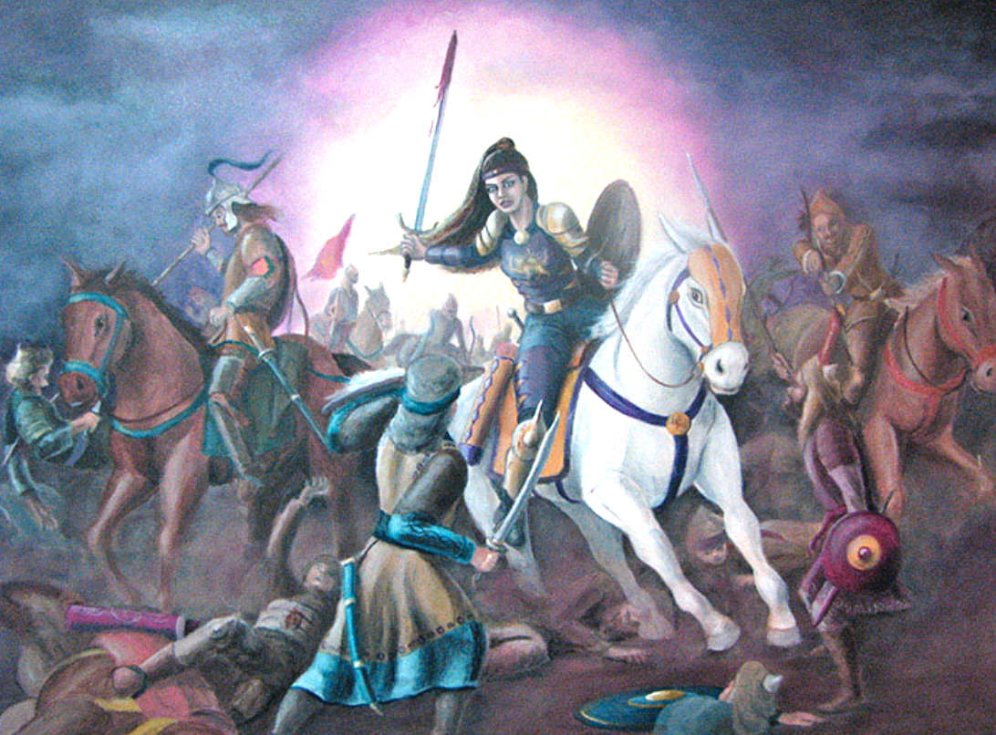
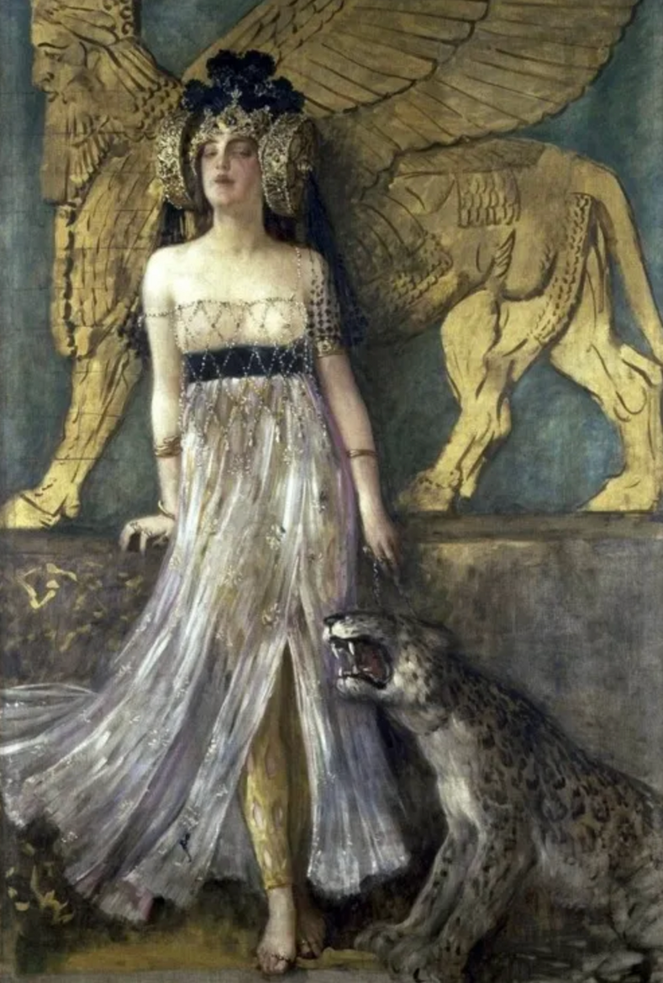
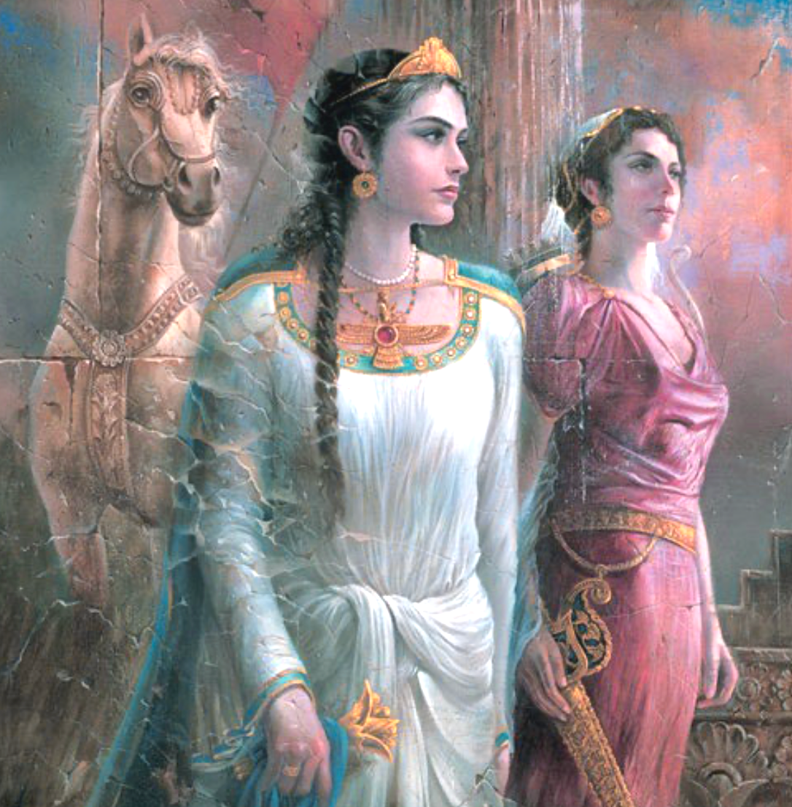
Assyrian queen Shammuramat
Legendary Commander Apranik of the Persian Sassanid Army

Slide 11
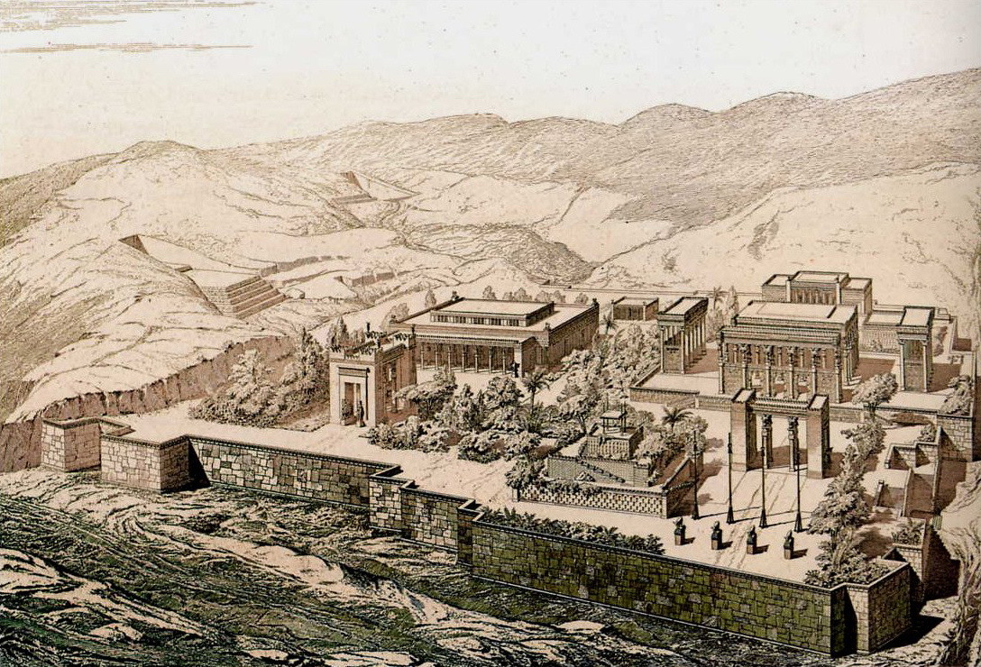
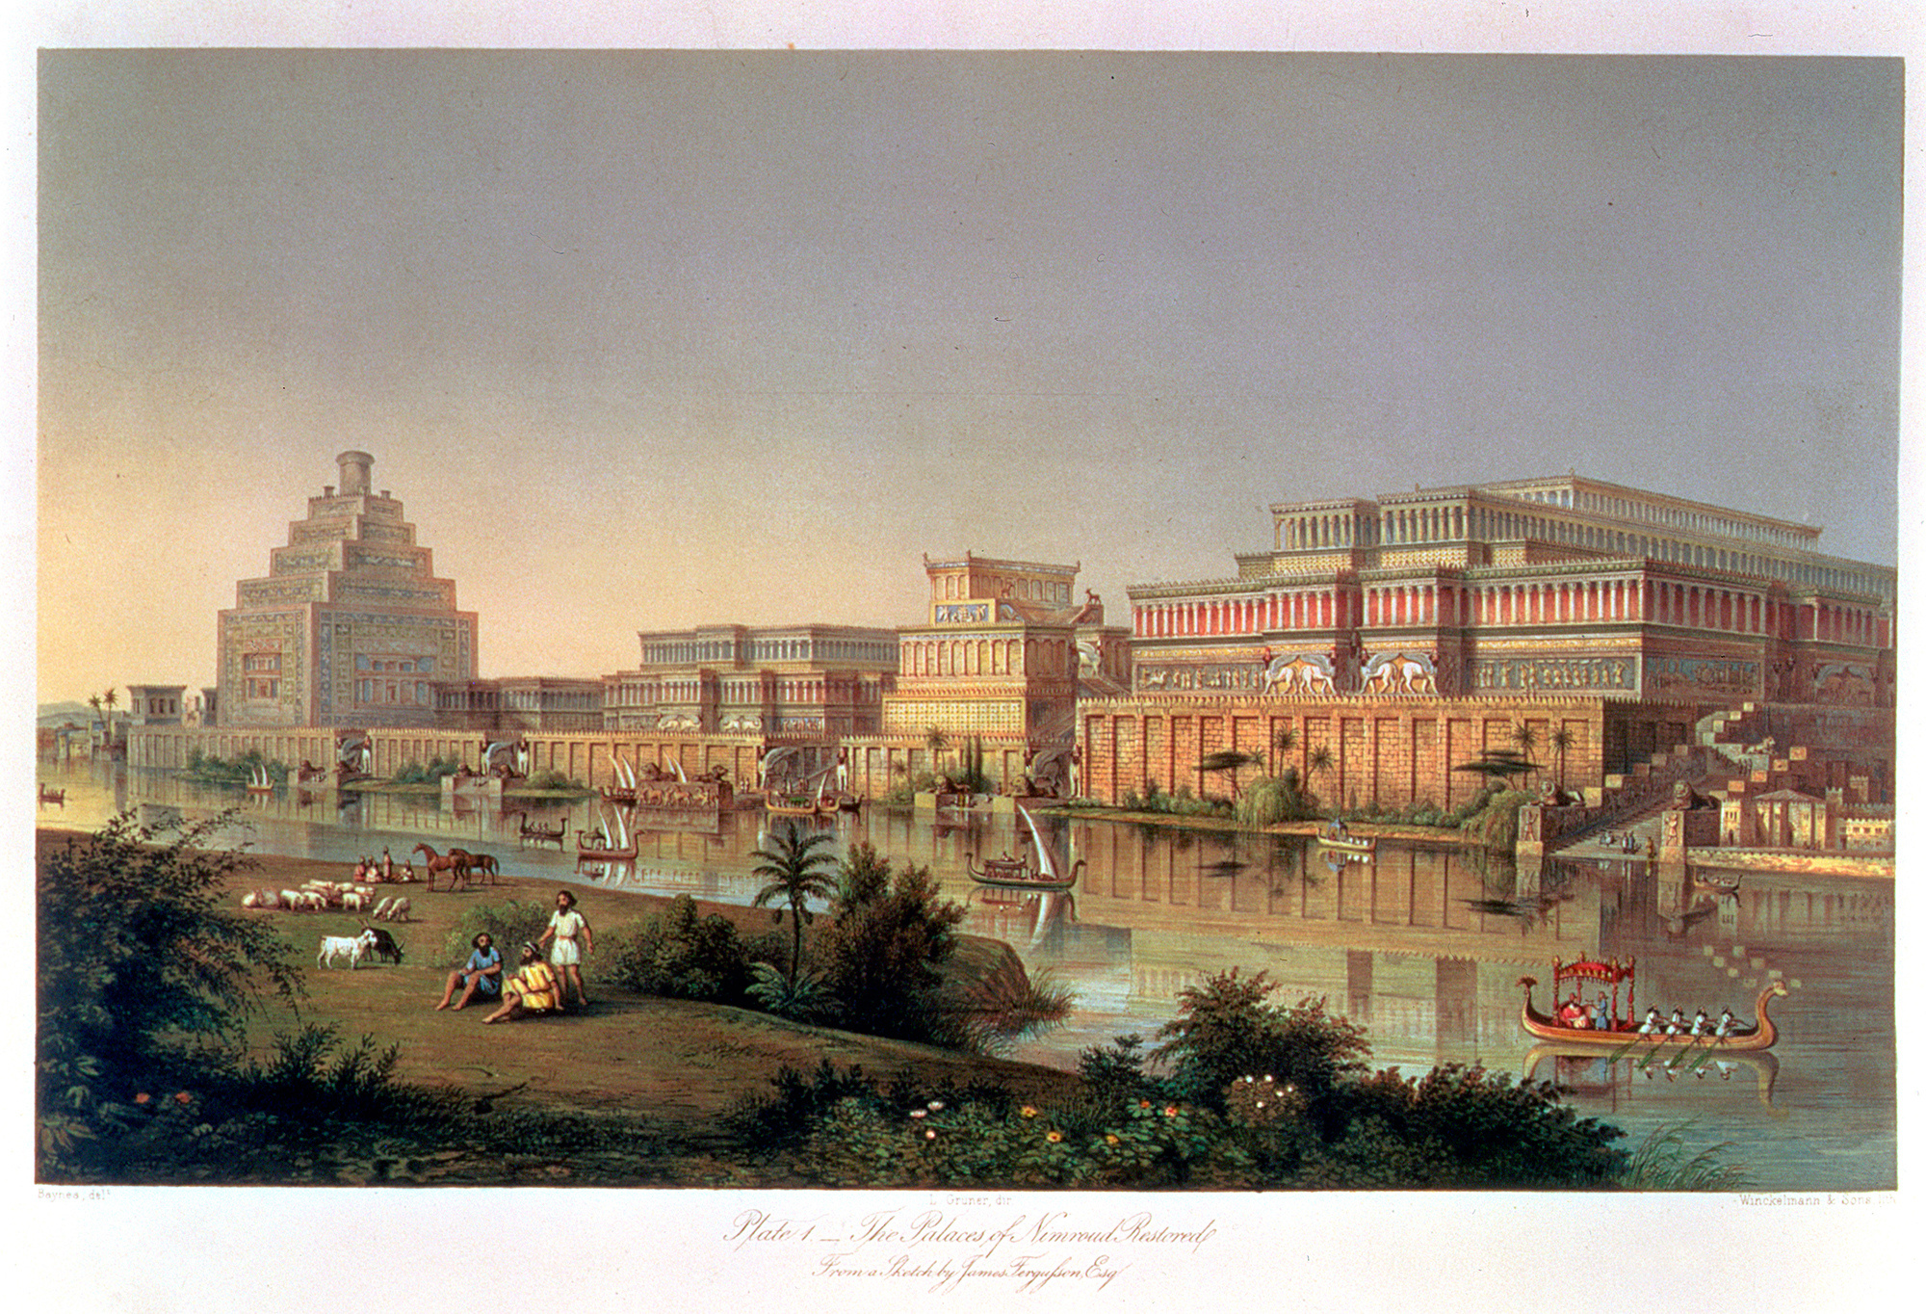
SUMMARY

Slide 12
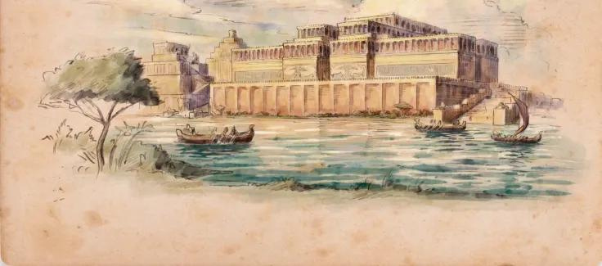
What we learn
Assyrian
- Importance of order and discipline in maintaining a stable society.
- Significance of a well-structured societal hierarchy.
- Administration and law enforcement as foundational to understanding governance.
- Contributions to the development of government and social structure.

Slide 13
What we learn
PERSIAN
- Value of tolerance and appreciation for cultural diversity.
- Importance of a flexible and integrated administrative structure.
- Governance model highlighting human dignity and cultural integration.
- Suitability of their approach for managing diverse civilizations.

Slide 14
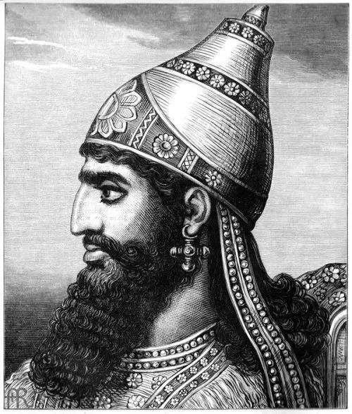

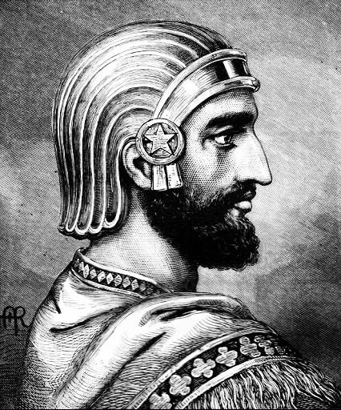
THANK YOU
Cyrus the Great
Ashur-uballit I

